Slide 1
INTRODUCTION TO THE INTERNET AND WORLD WIDE WEB
Chapter 1

Slide 2

THE WORLD WIDE WEB
The graphical user interface to information stored on computers
connected to the Internet.

Slide 3
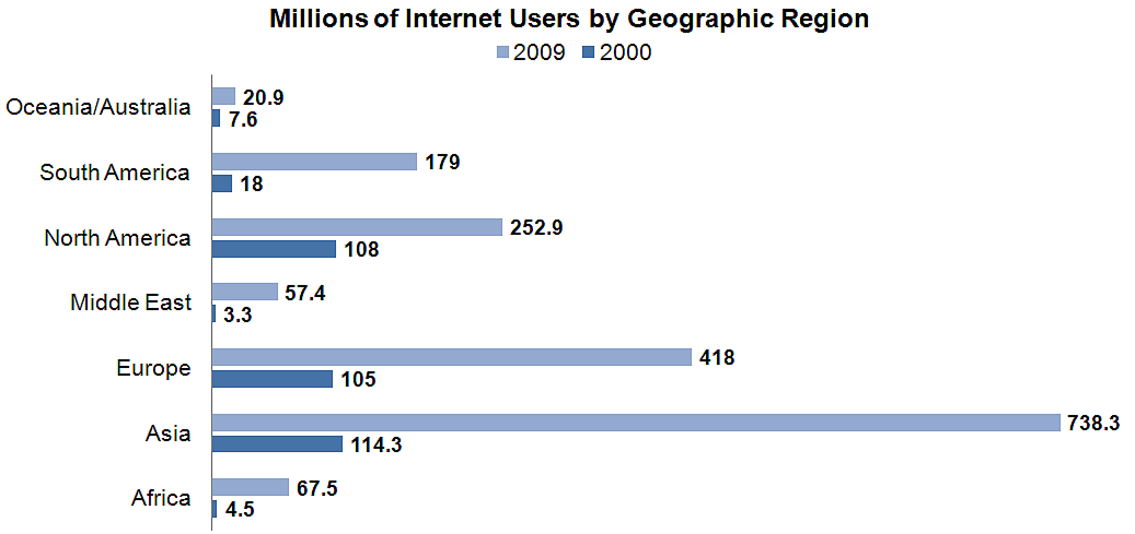
GROWTH OF THE INTERNET
http://www.internetworldstats.com/stats.htm

Slide 4
WEB STANDARDS
AND THE W3C CONSORTIUM
W3C – World Wide Web Consortium
  Develops recommendations and prototype technologies related to the Web
  Produces specifications, called Recommendations, in an effort to standardize web technologies
  WAI – Web Accessibility Initiative

Slide 5
WEB ACCESSIBILITY
Accessible Website
  provides accommodations for individuals with visual, auditory, physical, and neurological disabilities
WAI
  W3C’s Web Accessibility Initiative
  http://www.w3.org/WAI
WCAG
  Web Content Accessibility Guidelines
  http://www.w3.org/WAI/WCAG20/quickref/

Slide 6
UNIVERSAL DESIGN FOR THE WEB
Universal Design
  the design of products and environments to be usable by all people, to the greatest extent possible, without the need for adaptation or specialized design
http://www.ncsu.edu/www/ncsu/design/sod5/cud/about_ud/about_ud.htm

Slide 7
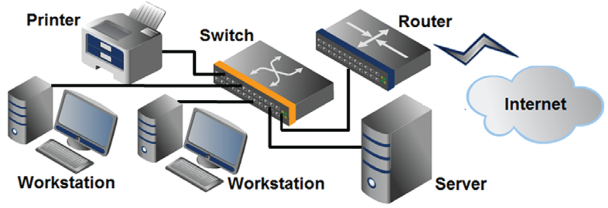
NETWORK OVERVIEW
Network
two or more computers connected together for the purpose of communicating and sharing resources

Slide 8
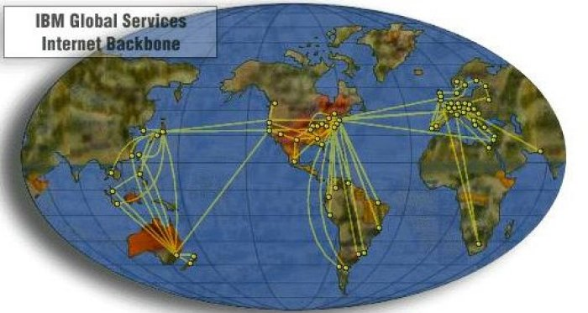
INTERNET INFRASTRUCTURE
Internet Backbone
A high capacity communication link that carries data gathered from smaller links that interconnect with it.
Source: http://www.alamo.edu/sac/library/faculty/deosdade/wwwtest2.htm

Slide 9
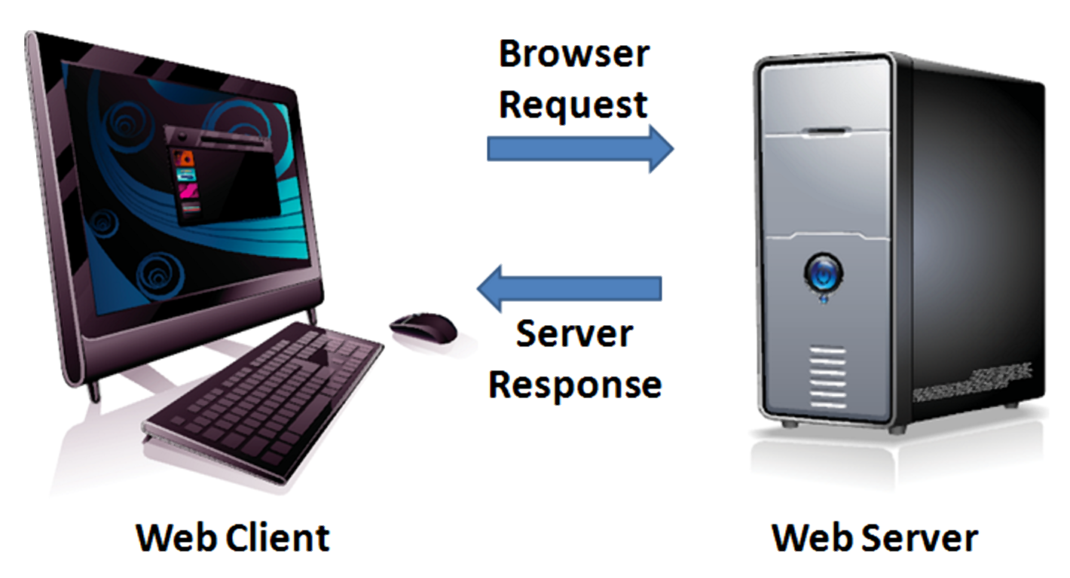
THE INTERNET CLIENT/SERVER MODEL
Client – Web Browser
Server – Web Server

Slide 10
INTERNET PROTOCOLS
Protocols
  Rules that describe the methods used for clients and servers to communicate with each other over a network.
There is no single protocol that makes the Internet and Web work.
A number of protocols with specific functions are needed.

Slide 11

HTTP - HYPERTEXT TRANSFER PROTOCOL
A set of rules for exchanging files such as text, graphic images, sound, video, and other multimedia files on the Web.
Web browsers send HTTP requests for web pages and their associated files.
Web servers send HTTP responses back to the web browsers.
http request
http
response

Slide 12
TCP/IP
TRANSMISSION CONTROL PROTOCOL/INTERNET PROTOCOL
TCP/IP has been adopted as the official communication protocol of the Internet.
TCP and IP have different functions that work together to ensure reliable communication over the Internet.

Slide 13
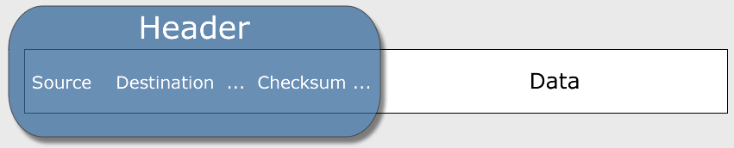
TCP
TRANSMISSION CONTROL PROTOCOL
Purpose is to ensure the integrity of communication
Breaks files and messages into individual units called packets

Slide 14
IP
INTERNET PROTOCOL
A set of rules that controls how data is sent between computers on the Internet.
IP routes a packet to the correct destination address.
The packet gets successively forwarded to the next closest router (a hardware device designed to move network traffic) until it reaches its destination.
http://visualroute.visualware.com/
http://www.tracert.com/cgi-bin/trace.pl

Slide 15
IP ADDRESS
Each device connected to the Internet has a unique numeric IP address.
These addresses consist of a set of four groups of numbers, called octets.
74.125.95.104 will get you Google!
An IP address may correspond to a domain name.

Slide 16
DOMAIN NAME
Locates an organization or other entity on the Internet
Domain Name System
  Divides the Internet into logical groups and understandable names
  Associates unique computer IP Addresses with the text-based domain names you type into a web browser
  Browser: http://google.com
  IP Address: 74.125.95.104

Slide 17
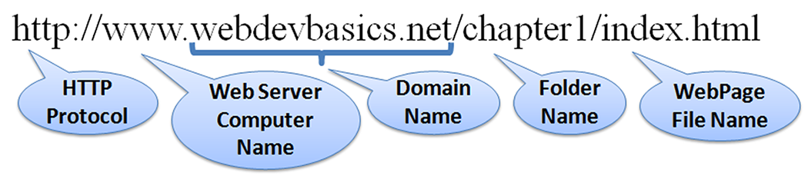
UNIFORM RESOURCE IDENTIFIER
URI – Uniform Resource Identifier
  identifies a resource on the Internet
URL – Uniform Resource Locator
  a type of URI which represents the network location of a resource such as a web page, a graphic file, or an MP3 file.

Slide 18
TLD
TOP-LEVEL DOMAIN NAME
A top-level domain (TLD) identifies the right-most part of the domain name.
Current generic TLDs:
.com, .org, .net, .mil, .gov, .edu, .int, .aero, .asia, .cat, .jobs, .name, .biz, .mobi, .museum, .info, .coop, .post, .pro, .tel, .travel, .xxx

Slide 19
COUNTY CODE TLDS
Two character codes originally intended to indicate the geographical location (country) of the web site.
In practice, it is fairly easy to obtain a domain name with a country code TLD that is not local to the registrant.
Examples:
  .tv, .ws, .au, .jp, .uk
  See http://www.iana.org/cctld/cctld-whois.htm

Slide 20



DOMAIN NAME SYSTEM
The Domain Name System (DNS) associates
Domain Names with IP addresses.
Web
Browser
Domain Name
DNS
IP Address
Web
Server
Use TPC/IP
to send HTTP Request
Use TCP/IP
to send HTTP Responses
with web page files & images
Web Browser
displays web page
Copyright © Terry Felke-Morris

Slide 21
MARKUP LANGUAGES
SGML – Standard Generalized Markup Language
  A standard for specifying a markup language or tag set
HTML – Hypertext Markup Language
  The set of markup symbols or codes placed in a file intended for display on a web browser.

Slide 22
MARKUP LANGUAGES (2)
XML – eXtensible Markup Language
  A text-based language designed to describe, deliver, and exchange structured information.
  It is not intended to replace HTML –
  it is intended to extend the power of HTML by separating data from presentation.

Slide 23
MARKUP LANGUAGES (3)
XHTML – eXtensible Hypertext Markup Language
  Developed by the W3C as the reformulation of HTML 4.0 as an application of XML.
  It combines the formatting strengths of HTML 4.0 and the data structure and extensibility strengths of XML.

Slide 24
MARKUP LANGUAGES (4)
HTML 5
  The next version of HTML 4 and XHTML
  http://www.w3.org/html/

Slide 25
Q&A

